Slide 1
MOBILE SIGNAL JAMMER
PREPARED BY
DHARSHAN S (927623BEC034)
DHARSHAN T (927623BEC035)
DHIVAKAR B(927623BEC046)

Slide 2
Abstract
A mobile signal jammer is an electronic device designed to disrupt or block communication between mobile phones and cellular networks, rendering devices unable to receive or transmit signals.
They are commonly used in settings where mobile phones are undesirable, such as in high-security areas, government buildings, educational institutions, or during public events to maintain focus and prevent unauthorized communications.
While mobile signal jammers have a wide range of potential applications, their usage raises significant legal and ethical concerns due to their potential to interfere with legitimate communications.
This paper explores the principles behind mobile signal jamming, its applications, the technology involved, and the challenges related to its legal status and impact on public safety

Slide 3
Introduction
A mobile signal jammer is an electronic device designed to block or interfere with mobile phone communications by emitting radio frequency (RF) signals that disrupt the signals between mobile phones and cellular networks.
These devices can range from small, portable models to large systems capable of jamming signals over a wide area.
Mobile signal jammers are used in various applications, including in security-sensitive environments such as prisons, military installations, and government buildings, as well as in settings like schools or public events to prevent distractions or unauthorized communication.
However, their use raises significant legal and ethical concerns, as they can also interfere with emergency communications and legitimate services, leading to regulatory challenges. This technology’s growing prevalence underscores the need to balance security measures with public safety and communication rights.

Slide 4
Objectives
The objective of a mobile signal jammer is to prevent or disrupt mobile phone communications within a specific area by emitting interference signals that block or degrade the connection between mobile devices and cellular networks.
This technology aims to ensure security and privacy in sensitive environments, such as government buildings, military zones, prisons, and educational institutions, where mobile phone usage may pose a threat to safety, confidentiality, or productivity.
Additionally, the goal is to maintain control over communication in areas requiring strict regulation, minimizing the risk of unauthorized communication during critical operations or public events.
However, the design and deployment of mobile signal jammers must also consider legal and ethical implications to avoid interference with legitimate communications and emergency services.

Slide 5
Components Used
8 pin IC pin base
IC 555 Timer
Transistor
Capacitor
Resistor
30 pf variable Trimmer
Red LED
Antenna (Wire )
Dot board
Two pin Terminal block
Jumper Wires

Slide 6
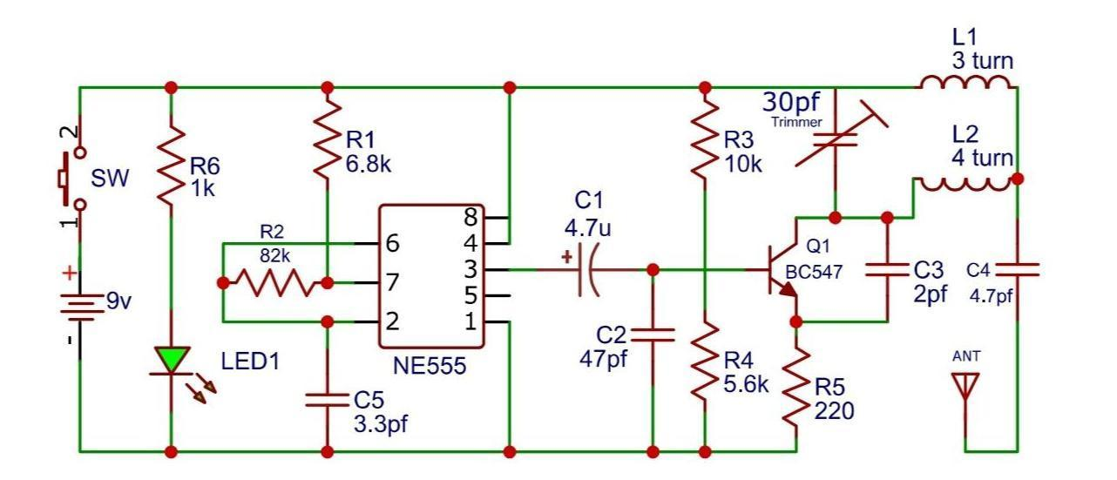
CIRCUIT DIAGRAM

Slide 7
Working Principle
The circuit is a simple RF transmitter designed using an NE555 timer and a BC547 transistor.
The NE555 timer is configured in astable mode to generate a high-frequency square wave at its output (pin 3).
The output of the 555 timer drives the base of the BC547 transistor through R4 (5.6kΩ).
The BC547 transistor amplifies the signal to drive the RF oscillation circuit.
The antenna radiates the RF signal.
LED1 acts as a power indicator.
The circuit is powered by a 9V supply, controlled by a switch (SW).
This circuit is commonly used for low-power RF transmission applications.

Slide 8
Application
Military and Defense:Prevent unauthorized communications, disrupt enemy networks, and neutralize remote-controlled devices, such as IEDs.
Prisons: Block mobile phone usage by inmates to prevent illegal activities and smuggling operations.
Government Buildings:Ensure confidentiality by preventing unauthorized communication and protecting sensitive information.
Public Events:Enhance security by preventing remote detonation of explosives and unauthorized transmissions.

Slide 9
Advantages
Enhanced Security: Prevents unauthorized communications in sensitive environments such as military zones, government buildings, and prisons.
Prevention of Illegal Activities: Blocks inmates from using smuggled phones to coordinate criminal operations inside prisons.
Protection Against Remote Threats: Disables remote-controlled devices, such as explosives, by blocking triggering signals.
Reduced Distractions: Minimizes mobile phone disturbances in educational institutions, theaters, and places of worship, enhancing focus and maintaining decorum.
Safeguarding Confidentiality: Ensures that sensitive information remains protected during meetings or classified operations by preventing unauthorized transmissions.

Slide 10
Future Scope
The future scope of mobile signal jammers lies in their ability to adapt to emerging technologies such as 5G and beyond, requiring innovations to target higher frequency signals and more complex network structures.
With advancements, jammers could become more selective, offering localized interference without disrupting broader communications, making them more efficient and precise.
Additionally, the use of jammers may expand into areas like smart city management and sensitive data environments, where controlling mobile usage is essential.
However, as mobile networks grow more intricate, the challenge will be to balance the enhanced capabilities of jammers with legal and ethical considerations, ensuring they do not interfere with emergency communications or public safety while addressing evolving security needs.

Slide 11
Conclusion
In conclusion, mobile signal jammers serve as effective tools for controlling and restricting mobile phone communications in environments where security, privacy, or operational control is a priority.
These devices are widely used in settings such as government buildings, military zones, prisons, and certain public events to prevent unauthorized communication, enhance safety, and ensure focus.
However, while their utility is evident, the use of mobile signal jammers raises significant legal and ethical challenges, particularly regarding their potential to interfere with emergency services and legitimate communications.
As technology continues to evolve, it is crucial to establish clear regulations and guidelines to balance the benefits of signal jammers with the need to protect public safety and communication rights.

Slide 12

THANK YOU

